Slide 1
Crypto Comparison
Joaquin Villamil

Slide 2
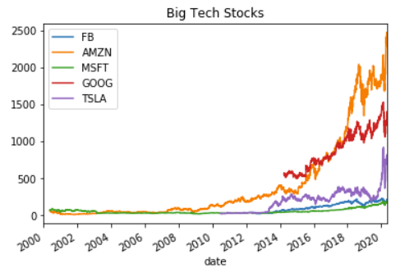
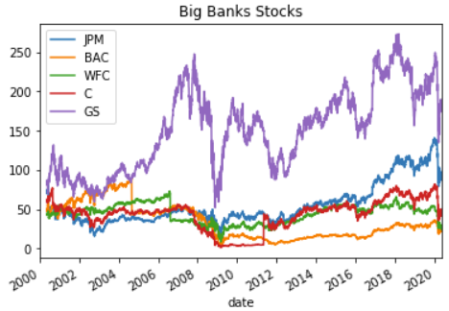
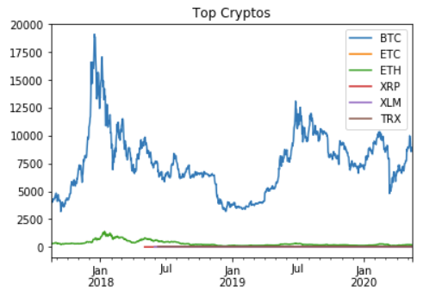
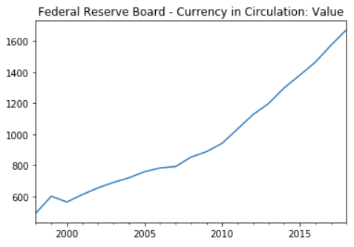
Data gathering
API (Python wrapper)
Alpha Vantage
API (Python wrapper)
Alpha Vantage
API
Alpha Vantage
Web Scrapping
Federal Reserve

Slide 3
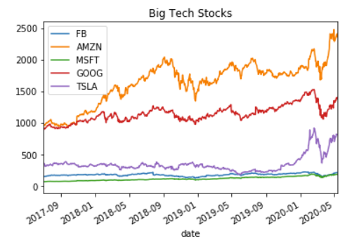
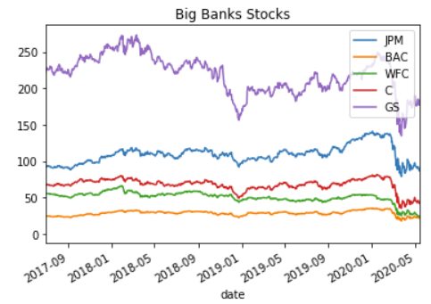
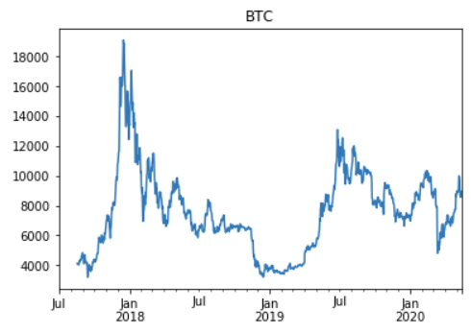
Tech & Banks Stocks vs BTC

Slide 4
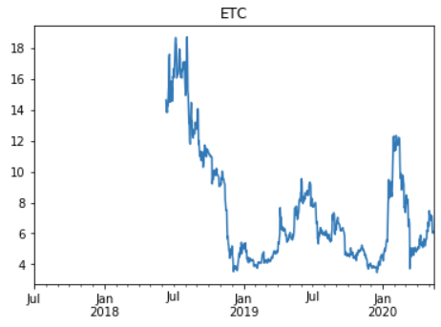
Tech & Banks Stocks vs ETC

Slide 5
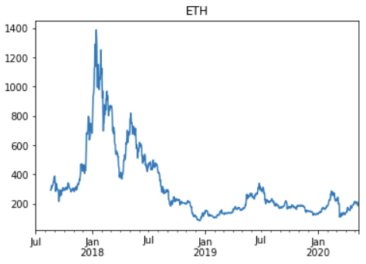
Tech & Banks Stocks vs ETH

Slide 6
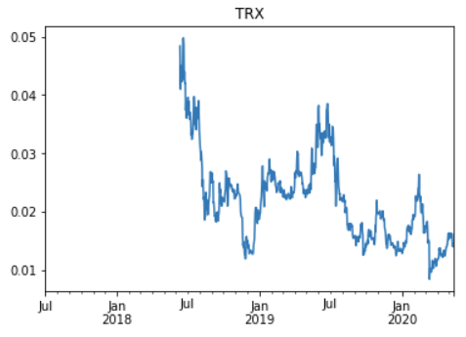
Tech & Banks Stocks vs TRX

Slide 7
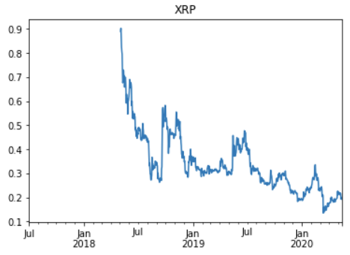
Tech & Banks Stocks vs XRP

Slide 8
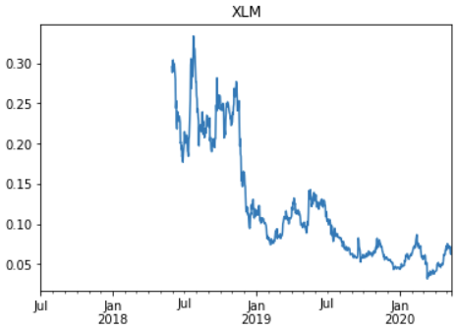
Tech & Banks Stocks vs XLM

Slide 9
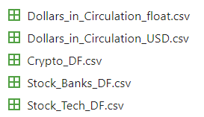
CSV Files generated
5 databases generated
4 types of data for comparison
3 types of data gathering

Slide 10
Next updates
Total USD in circulation (2000 – 2020)
Include market Indexes worldwide
Cross comparison between currency volumen and crypto
Cross comparison between market indexes and crypto
Economic news feeling data base
Co-relate public feeling with the impact in crypto
Predection module for top cryto-currencies
Basics: ¿How to include ML into a data modeling for prediction?

